Slide 1
Adruino Basics
Ардуино осноВИТЕ

Slide 2
Ден 5
Home Automation с Ардуино вление на „тежки товари” с Ардуино с Ардуино

Slide 3
Управление на „тежки товари” с Ардуино
Проблеми при „тежките товари”;
Транзистори;
Релета;
Управление на електродвигател с транзистор;
Защита на Ардуино пиновете;

Slide 4
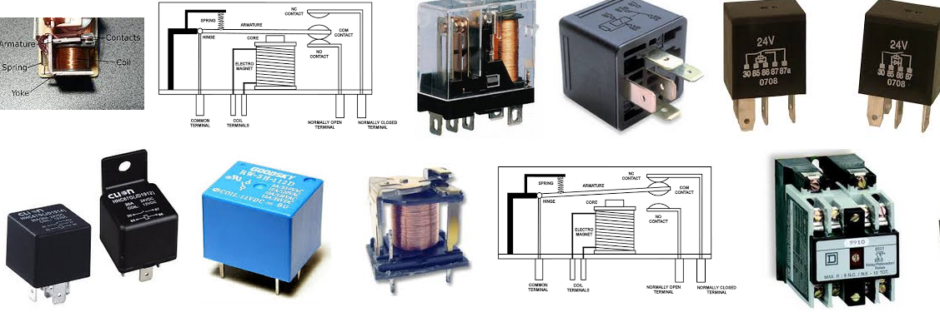
RELAYS

Slide 5
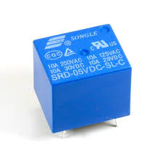
Reading Songle

Slide 6
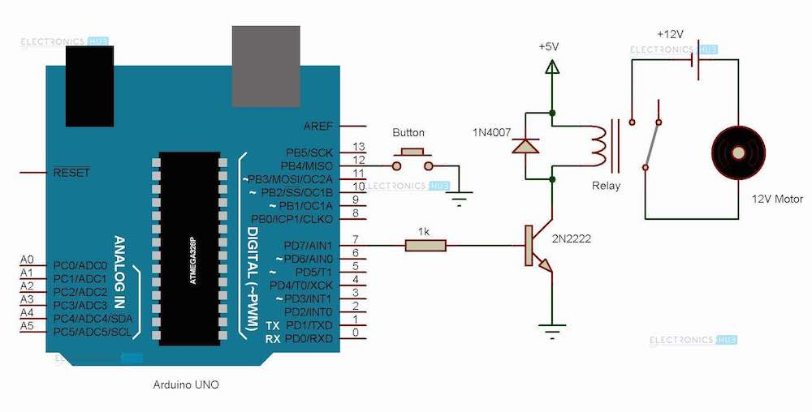
Direct Connection
Notes:
http://www.electronicshub.org/arduino-relay-control/
1N4007 Diode: This diode acts as a flyback or a freewheeling diode in the circuit. Such diodes are often used in inductive circuits. When the power to the circuit is turned off, since the coil in the relay is an inductor, the current in it cannot be changed instantly. In such cases, a freewheeling diode provides a path to the current.
Diodes are often used in DC powered inductive circuits whereas a snubber circuit is used in AC powered inductive circuits.
2N2222 Transistor: It is an NPN transistor generally used for medium power amplifier and switching applications for currents up to 1 A. In this project, it is used as a switch which turns on or off the relay.

Slide 7
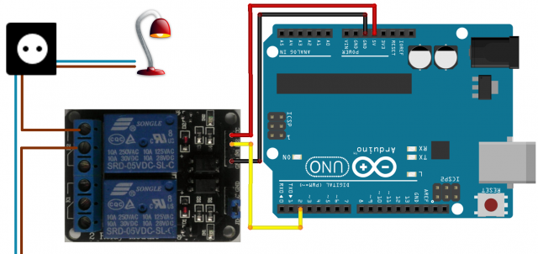
RELAYS

Slide 8
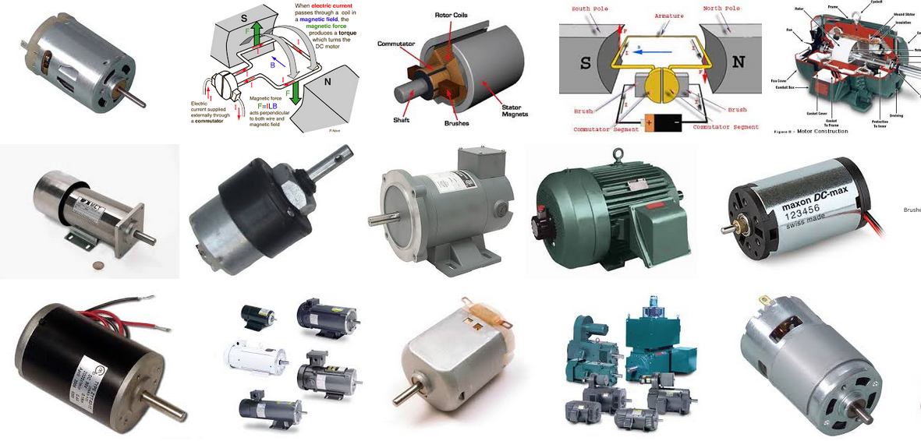
DC Motors

Slide 9
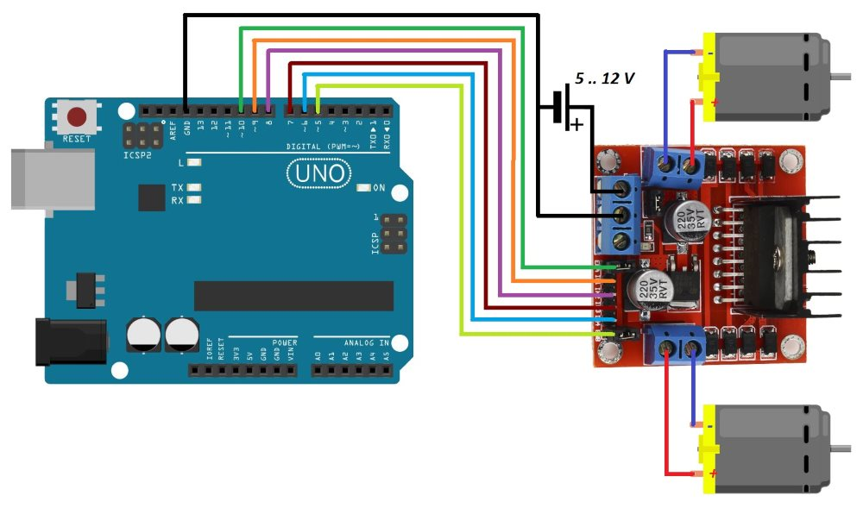
DC Motors + L298N

Slide 10
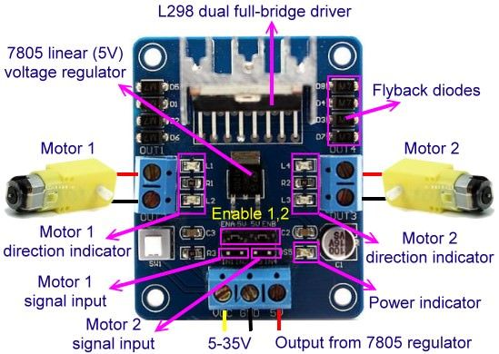
DC Motors – SPEED COntrOL

Slide 11
TRUTH TABLE
M | E (PWM) enable | Action
LOW | 0 | STOP
LOW | 150 | FORWARD
HIGH | 0 | STOP
HIGH | 150 | BACKWARD

Slide 12
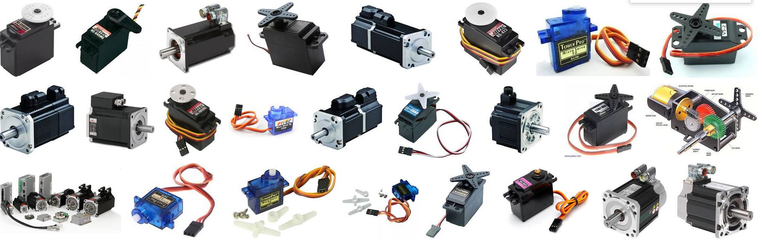
Servo Motors
Notes:
https://www.arduino.cc/en/Tutorial/Sweep

Slide 13
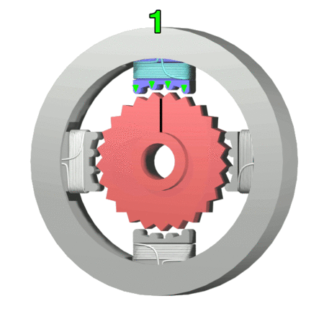
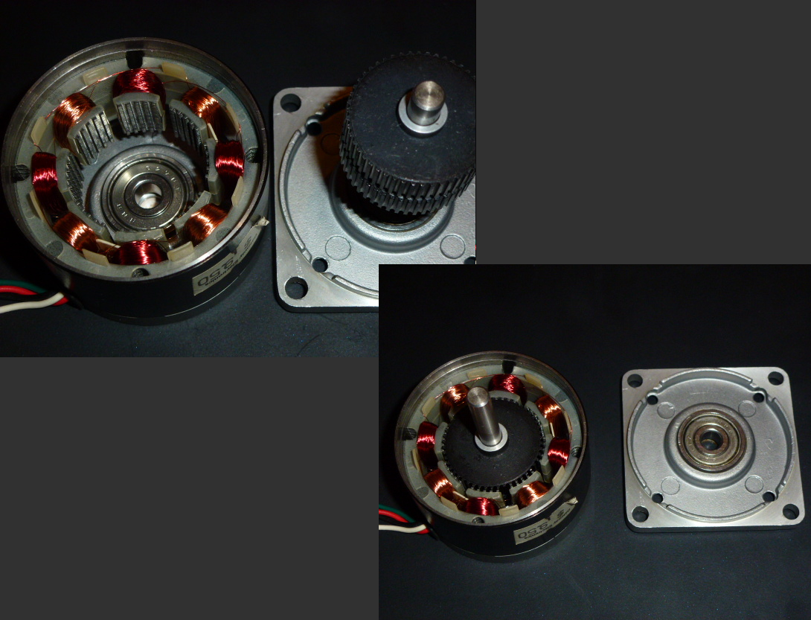
Servo Motors – Position Control

Slide 14
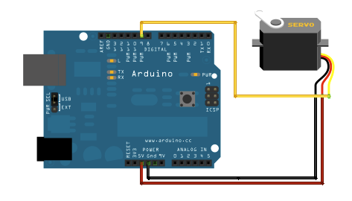
Source SERVO CONTROL
Отворете Ардуино IDE.
От менюто изберете Files -> Examples -> Servo -> SWEEP
https://www.arduino.cc/en/Tutorial/Sweep
Notes:
https://www.arduino.cc/en/Tutorial/StepperSpeedControl

Slide 15
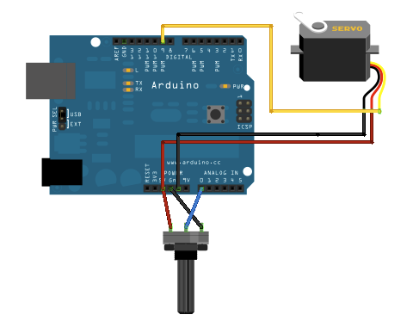
Source SERVO KNOB
Отворете Ардуино IDE.
От менюто изберете Files -> Examples -> Servo -> KNOB
https://www.arduino.cc/en/Tutorial/Knob
Notes:
https://www.arduino.cc/en/Tutorial/StepperSpeedControl

Slide 16
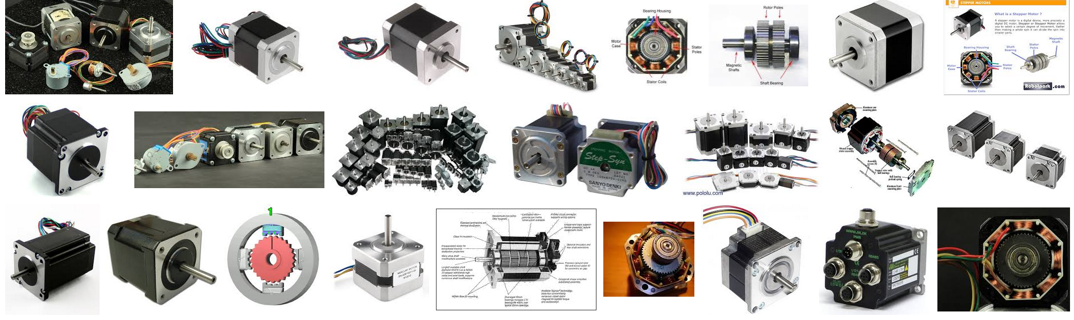
Stepper Motors

Slide 17
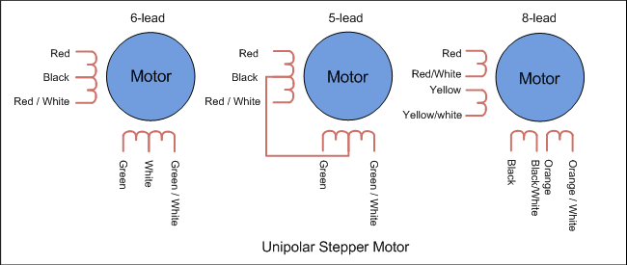
Stepper Motors - UniPOLAR
Notes:
6 PINA – Unipolar.
4 Pina – Bipolar.
https://www.circuitspecialists.com/blog/unipolar-stepper-motor-vs-bipolar-stepper-motors/

Slide 18
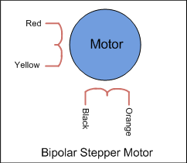
Stepper Motors - BIPOLAR
Notes:
6 PINA – Unipolar.
4 Pina – Bipolar.
https://www.circuitspecialists.com/blog/unipolar-stepper-motor-vs-bipolar-stepper-motors/

Slide 19
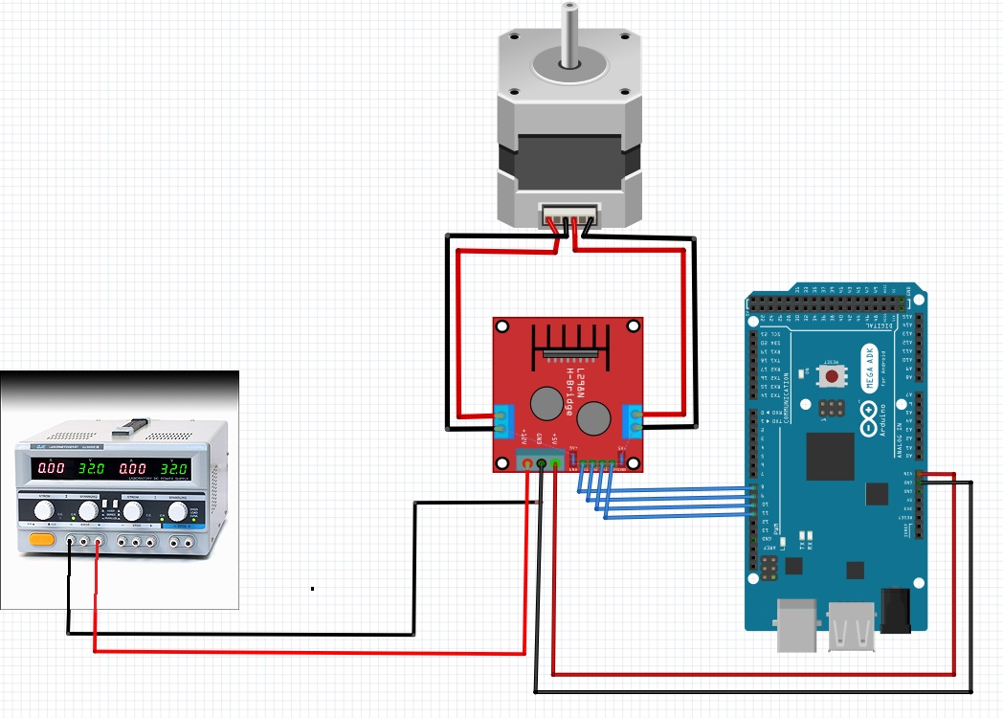
Stepper Motors
Notes:
https://tronixlabs.com.au/news/tutorial-l298n-dual-motor-controller-module-2a-and-arduino/
The motor direction is controlled by sending a HIGH or LOW signal to the drive for each motor (or channel). For example for motor one, a HIGH to IN1 and a LOW to IN2 will cause it to turn in one direction, and a LOW and HIGH will cause it to turn in the other direction.
However the motors will not turn until a HIGH is set to the enable pin (7 for motor one, 12 for motor two). And they can be turned off with a LOW to the same pin(s). However if you need to control the speed of the motors, the PWM signal from the digital pin connected to the enable pin can take care of it.
https://github.com/futureshocked/arduino_sbs/blob/master/DC%20Motors/DC_motor_with_distance_sensor/DC_motor_with_distance_sensor.ino

Slide 20
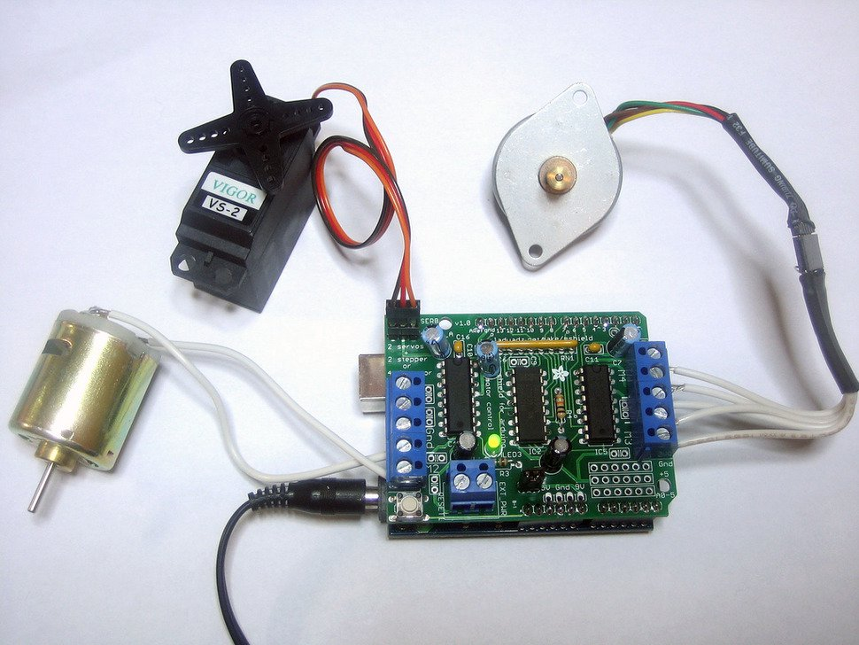
ADAFRUIT motor shield

Slide 21
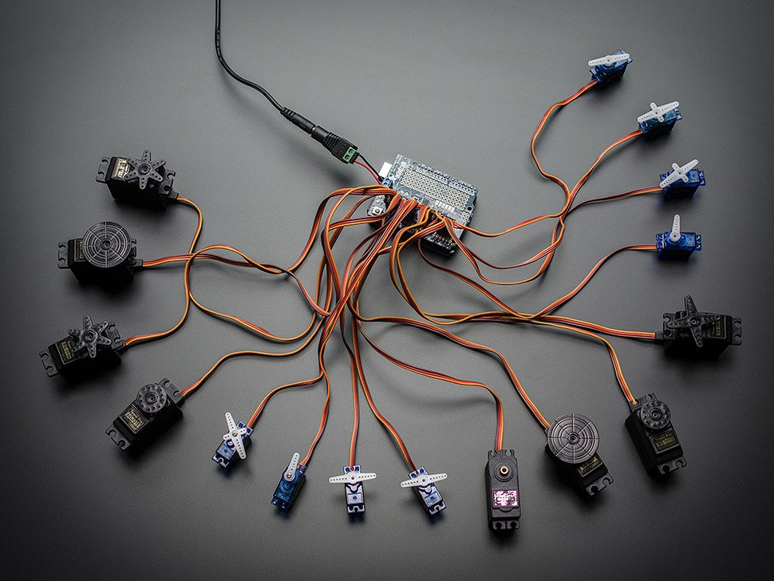
Adafruit 16 servo shield

Slide 22
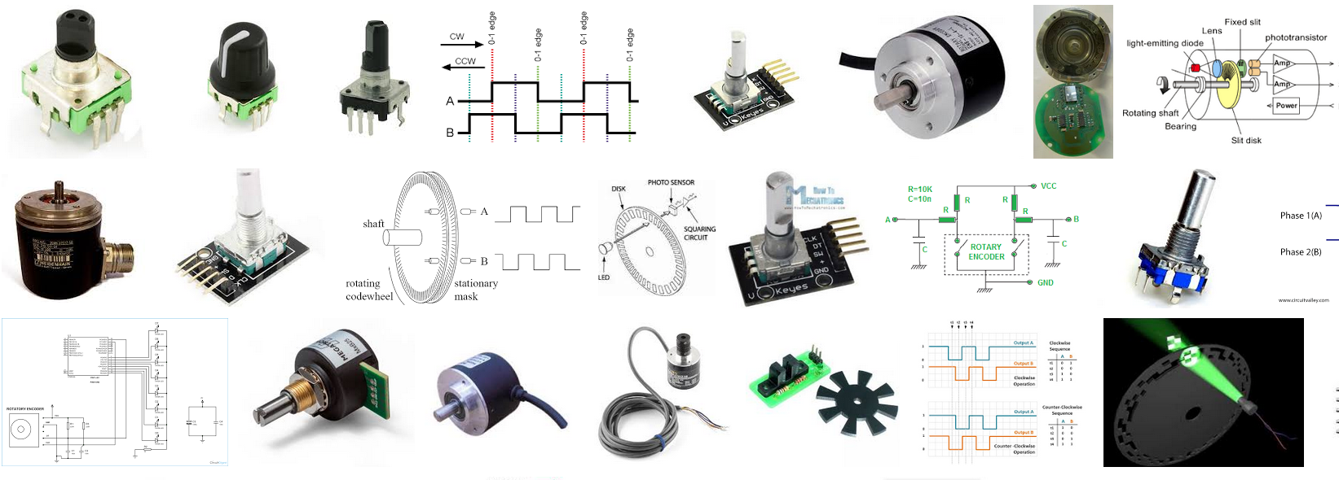
ROTARy ENCODERs

Slide 23
Rotari EnCoders
Conductive
Optical
On Axis Magnetic
Off Axis Magnetic
Absolute
Incremental
Notes:
On-Axis Magnetic: This technology typically uses a specially magnetized 2 pole neodymium magnet the same size as the motor shaft that typically requires a custom motor shaft be used. The accuracy is very bad and does not allow many resolution options. This technology does not typically offer UVW or Z pulse outputs. Due to the 2 pole magnet there is lots of jitter on the output due to the internal interpolation.
Off-Axis Magnetic: This technology typically employs the use of rubber bonded ferrite magnets attached to a metal hub. This offers flexibility in design and low cost for custom applications. Due to the flexibility in many off axis encoder chips they can be programmed to accept any number of pole widths so the chip can be placed in any position required for the application. Magnetic encoders operate in harsh environments where optical encoders would fail to work.
https://en.wikipedia.org/wiki/Rotary_encoder

Slide 24
http://playground.arduino.cc/Main/RotaryEncoders

Slide 25
MECHADUINO
https://www.kickstarter.com/projects/tropicallabs/mechaduino-powerful-open-source-industrial-servo-m

Slide 26
Stepper Mottor Control
https://www.arduino.cc/en/Tutorial/StepperSpeedControl

Slide 27
Почивка 15 мин

Slide 28
Упражнения - Управление на Серво двигател.
30 мин
Project 21 9g servo control 101

Slide 29
Упражнения - Автоматично светване на светлина
30 мин

